Slide 1
CC Web Frameworks
With a focus on Django

Slide 2
Web Frameworks at a glance
Models
Routing
Views
Templates
Jobs
Django specifics

Slide 3
Models
Comes with ORM: Essentially a wrapper around your database
Allows you to use records as objects
Migrations update your DB
Query support in Python
Example: Reporter.objects.get(full_name__startswith='John')

Slide 4
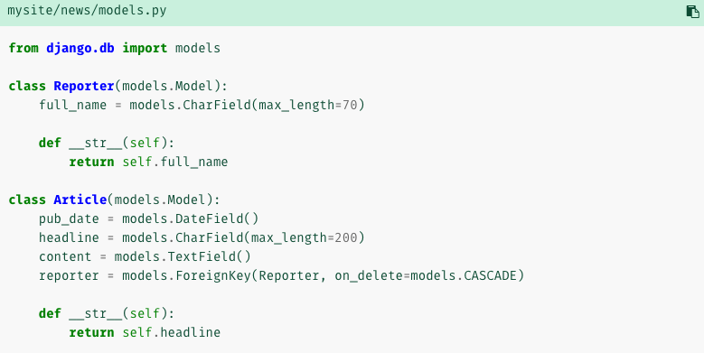

Slide 5
Routing
Map<URLPattern, PythonCallback>
URLPattern: Route
PythonCallbacks: Views
Upon request, Django will search mapping for first match (using RE)
If no pattern matches, 404 fallback
Views receive a request object which contains params, json body, etc.

Slide 6
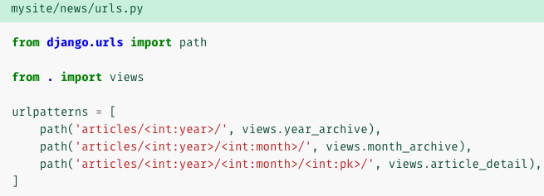

Slide 7
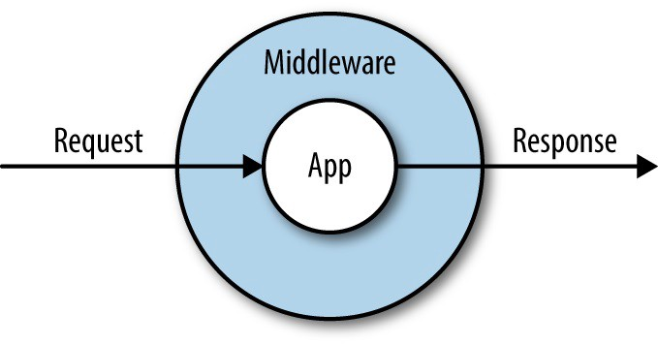
Middleware
Each layer is unaware of its predecessor / successor

Slide 8
Views
Either return an HttpReponse object or raise an exception
„Business logic“
Usually
Performs operations on input from request object (e.g. log in)
Loads a template (i.e. a configurable HTML file)
Renders and returns the template

Slide 9
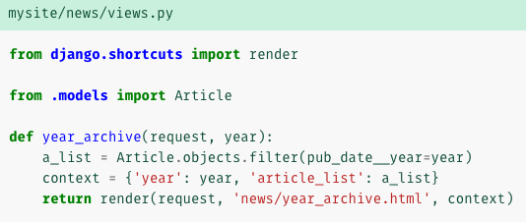

Slide 10
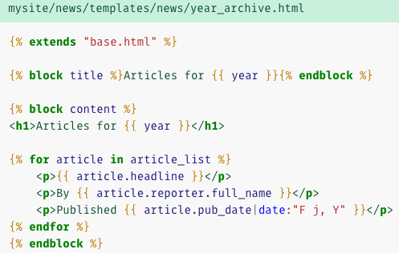
Templates
Template inheritance
Interpolation
Custom Python code
Template filter

Slide 11
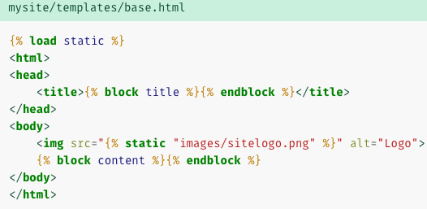
Hole for child to fill

Slide 12



Slide 13
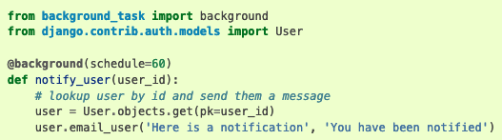
Jobs
Essentially a CRON Job wrapper
Jobs are scheduled (put on work queue), picked up by queue worker and executed
Configurable max retries, timeout, etc.

Slide 14
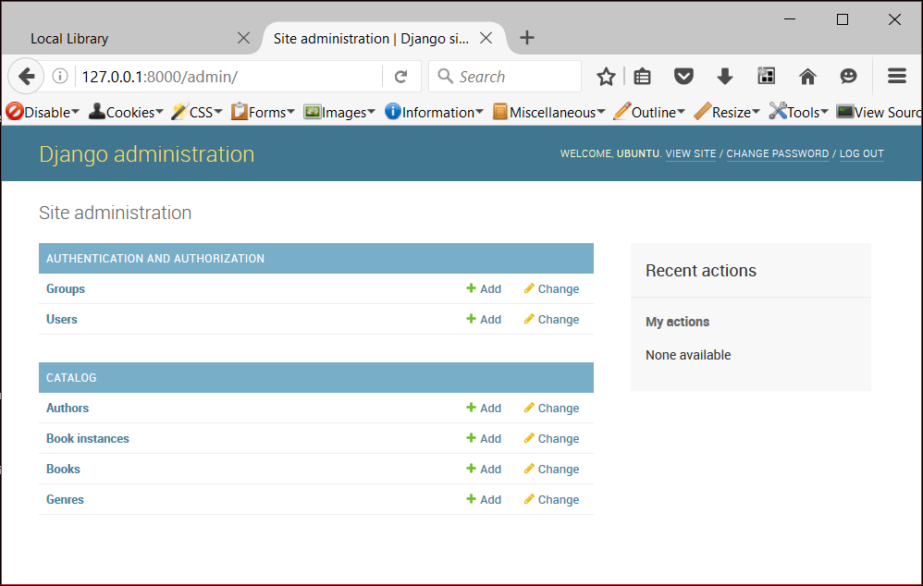
Django specifics
Built-In Admin Section

Slide 15
Django specifics
Built-in mitigation for common attack vectors (cross-site scripting, SQL injection, etc.)
Some of these have to be activated (CSS), others are available by default (e.g. parameter escaping for SQL queries)
Can be overridden by e.g. writing raw SQL

Slide 16
Resources
/r/django has a very positive view of the official tutorial
JavaScript and friends: https://developer.mozilla.org/en-US/
Approved Django specific tutorial: https://developer.mozilla.org/en-US/docs/Learn/Server-side/Django
DjangoGirls: https://tutorial.djangogirls.org/en/

